Slide 1


Modular R.O.V for Sub-Sea Operations
OLUYEMI FARAYIBI
JUAN GOMEZ
GUSTAV GUIJT
DAVID MARTINEZ
VICTOR ORTIZ
FINAL PROJECT
12/07/2015
Olly

Slide 2
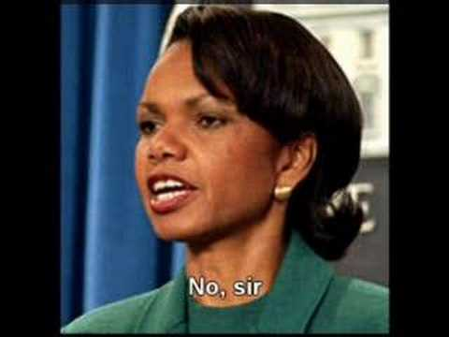
Safety Moment: Communication on the job
What is the solution to miscommunication? Ask Questions, write down instructions, review the information to be certain you fully understand, summarize the job so there is a clear picture of all that is to be done, break the job into several small steps.
Remember the single greatest cause of miscommunication is failure to communicate at all.
Olly

Slide 3
ROV Presentation Outline
Team Objectives
2016 MATE Competition
CFD Analysis Frame 1
CFD Analysis Frame 2
Frame Selection
Frame Updates
Control System
Arm Update
Tether Management System
Tether Design
Updated Project Budget
Updated Gantt Chart
Olly

Slide 4

Team Objective
Team HydroBurst’s primary objective is to design, test, and construct an underwater remotely operated vehicle (ROV) to compete in the 2016 National and International MATE Competitions.
Olly

Slide 5

2016 MATE Competition
Outer Space: Mission Europa
Measure thickness of ice
Measure total depth
Measure temp of thermal vents
Retrieve and connect ESP cable
David

Slide 6
CFD Analysis Frame 1
Displacement (in)
Von Mises Stress (psi)
Juan

Slide 7
CFD Analysis Frame 2
Displacement (in)
Von Mises Stress (psi)
Juan

Slide 8
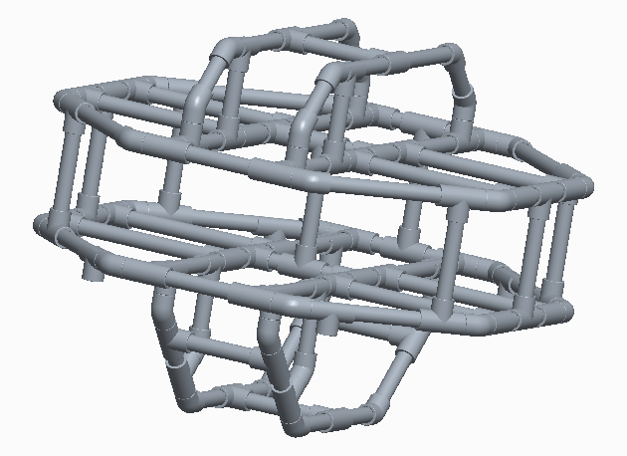
Frame Selection
Based on the Results of the Stress Analysis and CFD Analysis, we have decided to continue with Frame Design 5:
Gustav

Slide 9
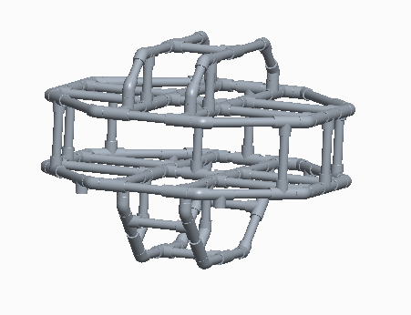
Frame Updates
Since the Last Presentation:
Modified top module into a smaller and permanent frame component.
Will contain control systems and sensors.
Gustav

Slide 10
Control System
Feedback Sensors:
Accelerometer.
Gyroscope.
3-in-1 Sensor: 9 Degrees of Freedom IMU (S24.95)
3-axis accelerometer
3-axis gyroscope
3-axis magnetometer
David

Slide 11
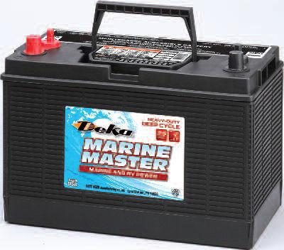
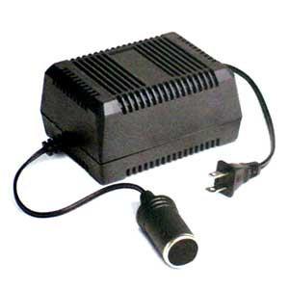
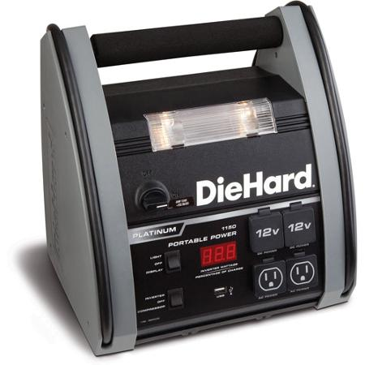
Battery Options
Deep Cycle Batteries
AC to DC Power Converters
Power Pack
David
Notes:
Batteries are rated by amp hours. The more the better. Keep im mind our motors run at 11 amps...

Slide 12
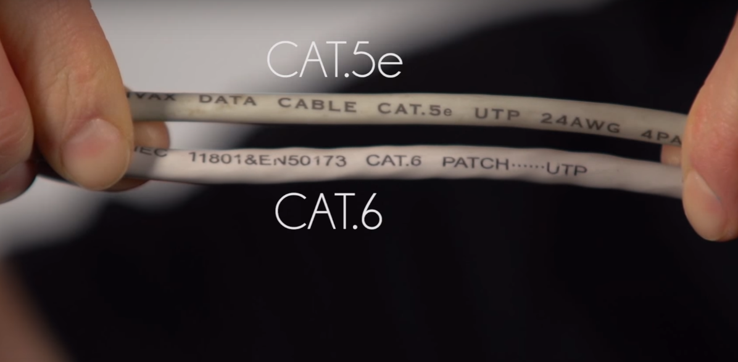
Ethernet Connection
All ethernet cables are not created equally...
David
Notes:
The Arduino uses an rj-45 connection which is ethernet. This connection can go up to 100 m which is roughly 300 ft. When picking a ethernet cable looking at the rating is important as certain wires can send a signal a certain speed and distance. Speed are sent in blocks 100mb, 10mb, etc

Slide 13
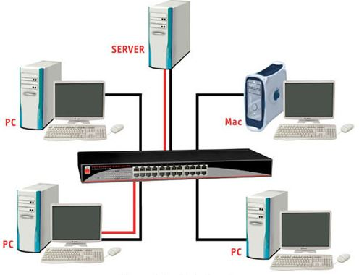

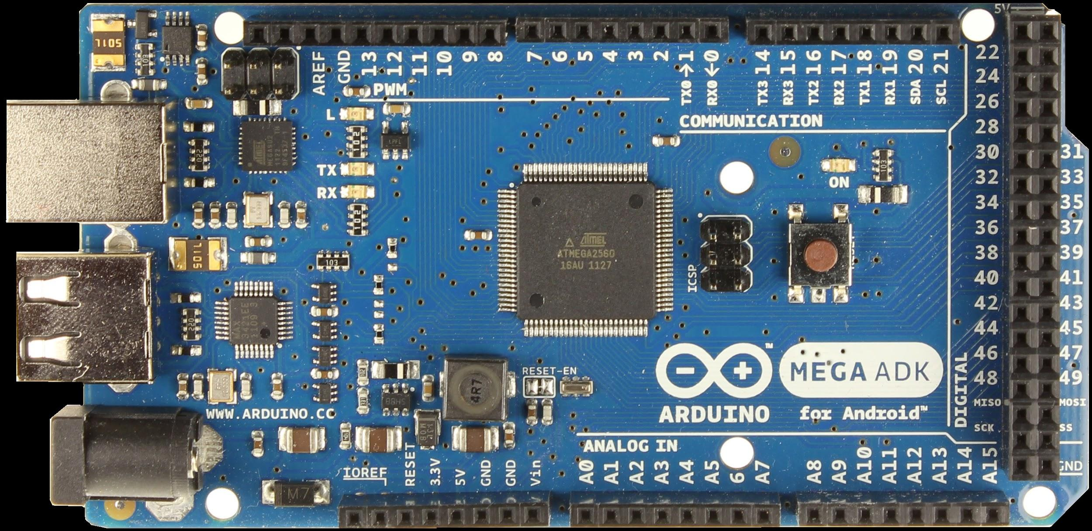
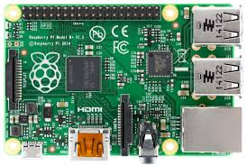
Ethernet Switching
David

Slide 14
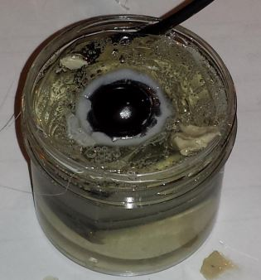
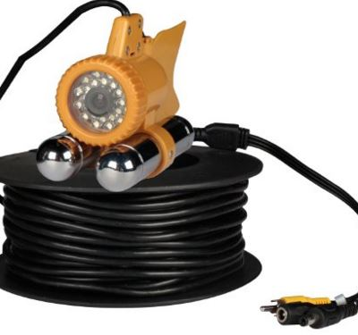
Pre-made vs. Homemade Cameras
Water proof car
camera
Fishing camera
David
Notes:
http://www.marinetech.org/files/marine/files/Curriculum/TriggerFish/Camera/CameraSealing1.pdf shows how to water proof a camera. All in all costs areound $50 to do. Fishing camera costs a lot but has 90 ft of cable already installed http://www.amazon.com/gp/product/B00J9OSAQ4/ref=pd_lpo_sbs_dp_ss_1?pf_rd_p=1944687582&pf_rd_s=lpo-top-stripe-1&pf_rd_t=201&pf_rd_i=B005CTKYB4&pf_rd_m=ATVPDKIKX0DER&pf_rd_r=083VCQEDC7DR5XBEM089

Slide 15
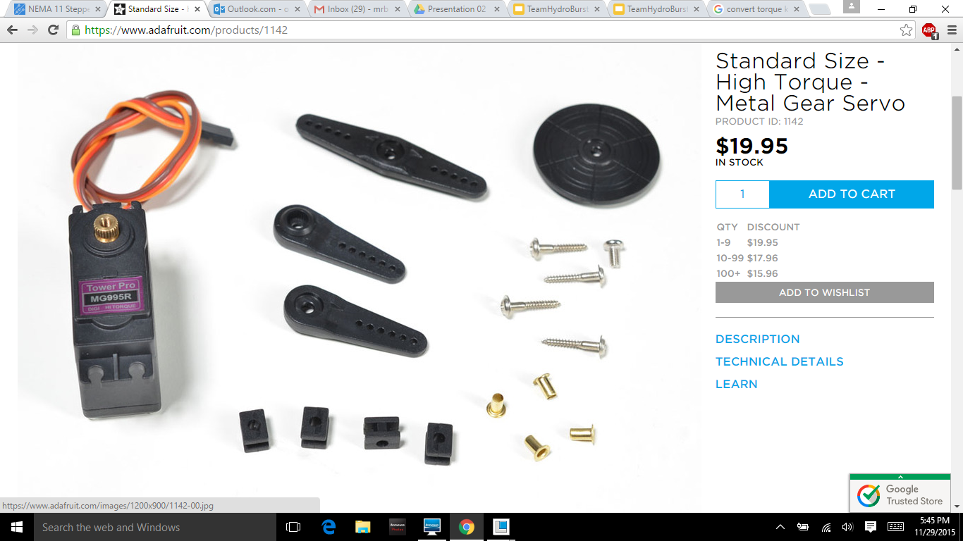
Arms Update
Motors:
Three High Torque metal gear servo motor
Specs:
Power: 6V
Avg Speed: 60° in 0.16 seconds
Torque: 10Kg-cm
Weight: 62.41g
Victor

Slide 16
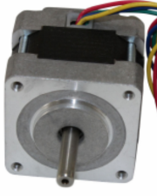
Arms Update
One NEMA 16 Stepper Motor
Specs:
Step angle: 1.8°
Voltage: 4.6V
Current: 0.65 A
Holding Torque: 1.8 Kg-cm
Control wires: 4
Victor

Slide 17
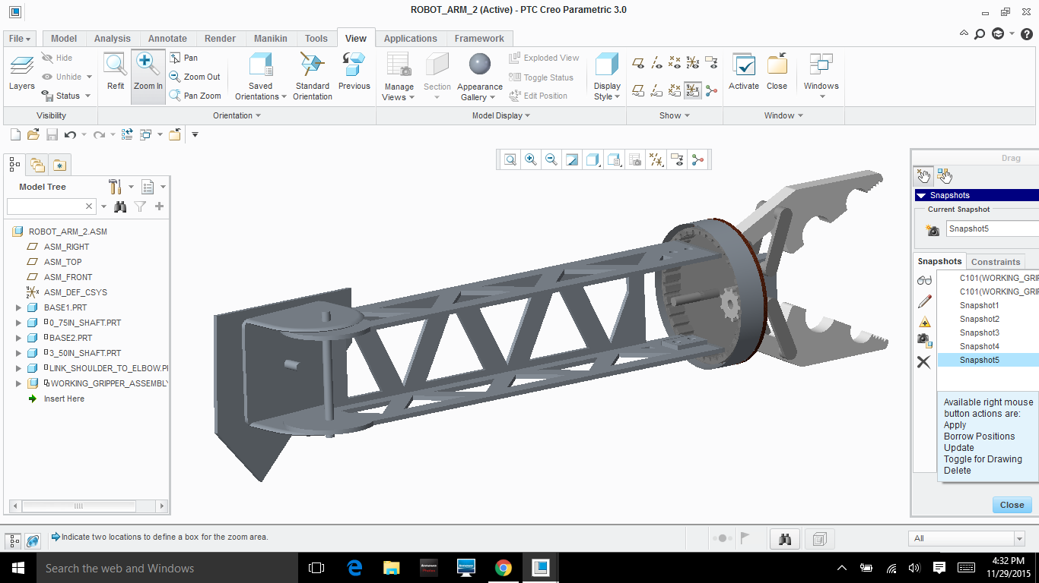
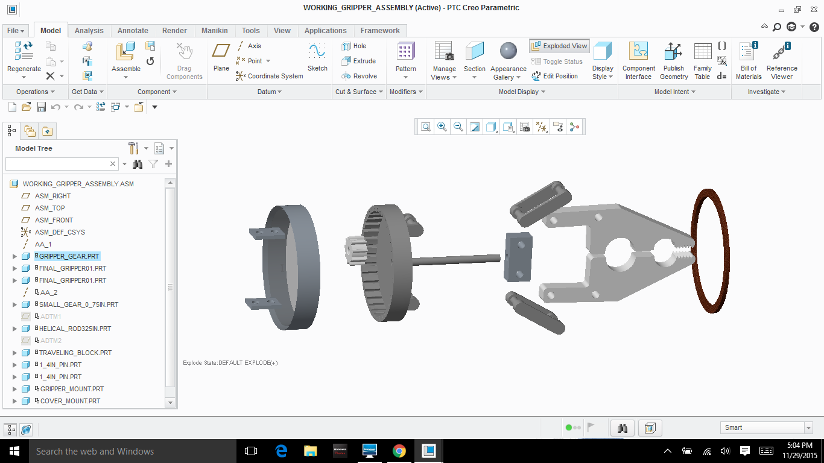
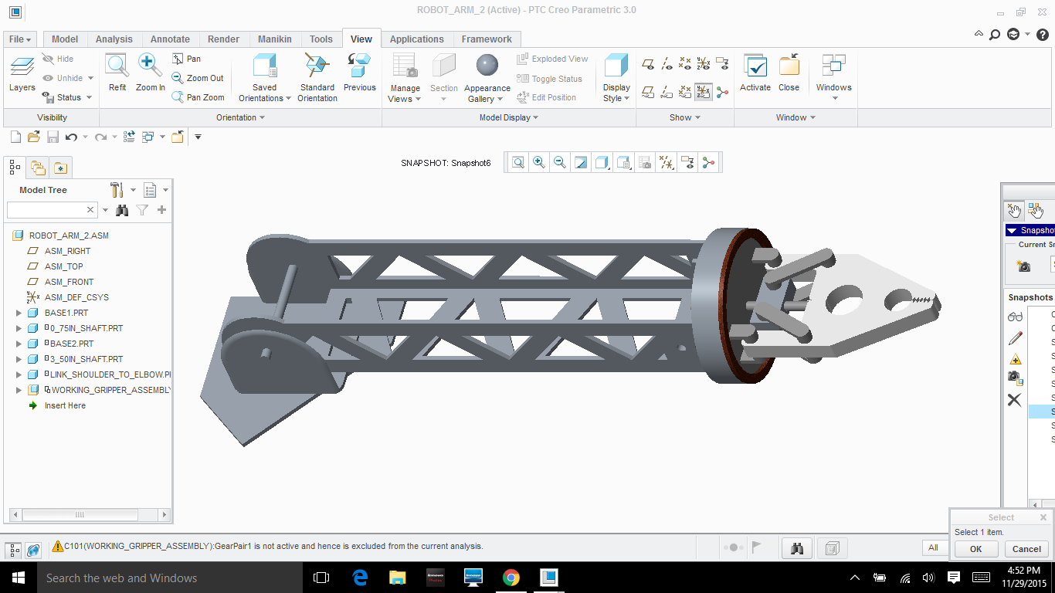
Arms Update
Victor
Notes:
6061 Aluminum Flat
⅛” X 2”
0.30 pounds per foot
6061 Aluminum Flat
⅛” X 2-½”
0.37 pounds per foot

Slide 18
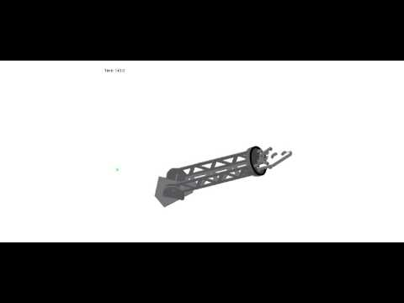
Arms Update
3 Degrees of Freedom
3 Metal Gear High Torque Servo motors
1 Stepper Motor
Victor
Notes:
6061 Aluminum Flat
⅛” X 2”
0.30 pounds per foot
6061 Aluminum Flat
⅛” X 2-½”
0.37 pounds per foot

Slide 19
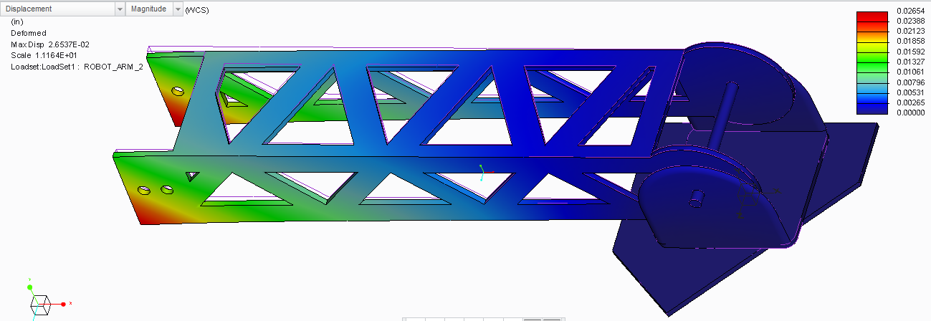
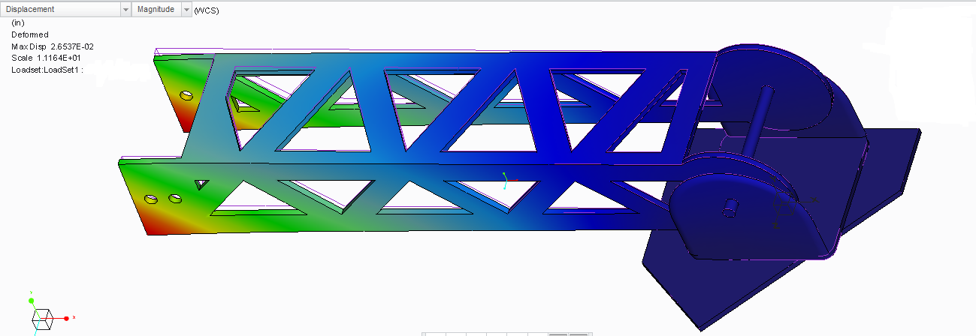
Arms Update
Victor
Notes:
6061 Aluminum Flat
⅛” X 2”
0.30 pounds per foot
6061 Aluminum Flat
⅛” X 2-½”
0.37 pounds per foot

Slide 20
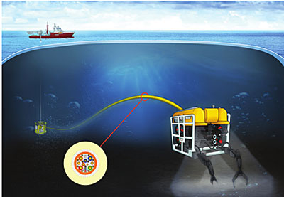
Tether Management System
MATE Competition Requirements:
Tether is included in the total weight of the ROV.
Needs to be able to reach 40 feet deep.
Team Decisions:
minimize the number of cables in Tether to reduce weight.
100 foot tether.
Gustav

Slide 21
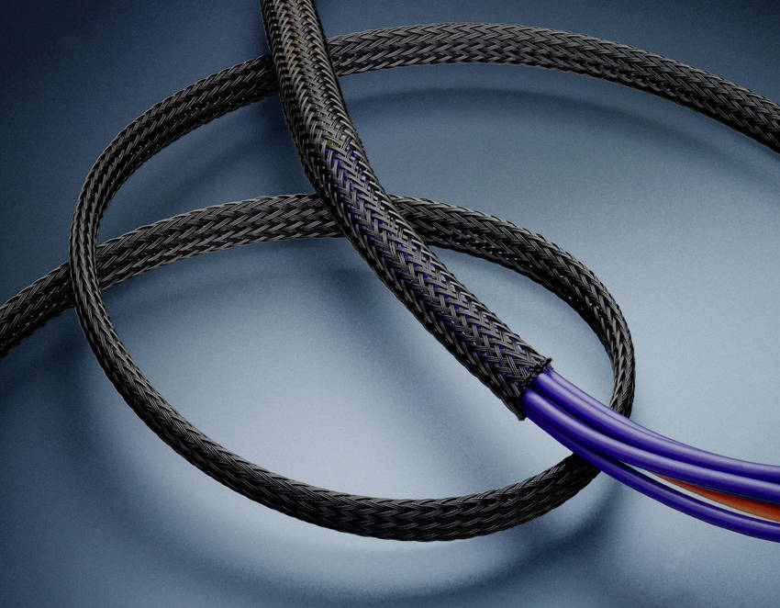
Tether Design
Necessary Cables:
100ft Power
100ft Ethernet
Optional Cables:
Additional Ethernet
Air pipe for pump
Cable Management Options:
Cable Ties
Cable Mesh Sleeve
Gustav

Slide 22
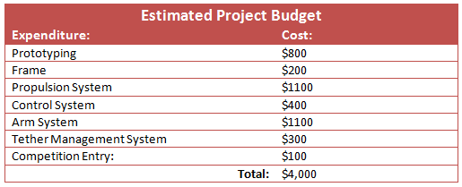
Updated Project Budget
Estimated Project Budget
Current Cash Flow:
Expenditures:
CPVC components ($86.35)
Income:
No Sponsors as of 12/07
Expenditure | Cost
PVC Frame | $200
Propulsion System | $750
Buoyancy | $
Control System | $
Arm System | $250
Tether Management System | $300
Competition Entry Fee | $150
Total Cost | $
Victor

Slide 23
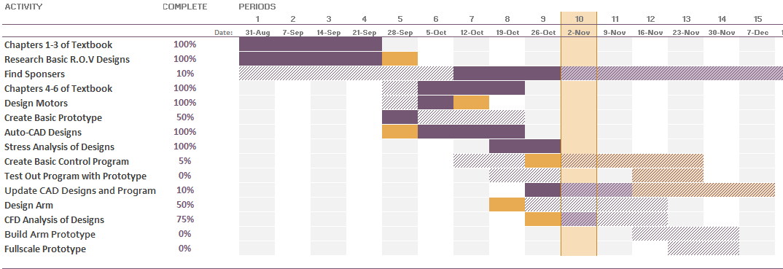
Updated Gantt Chart
Gustav

Slide 24

Thank You for Listening!

